Slide 1
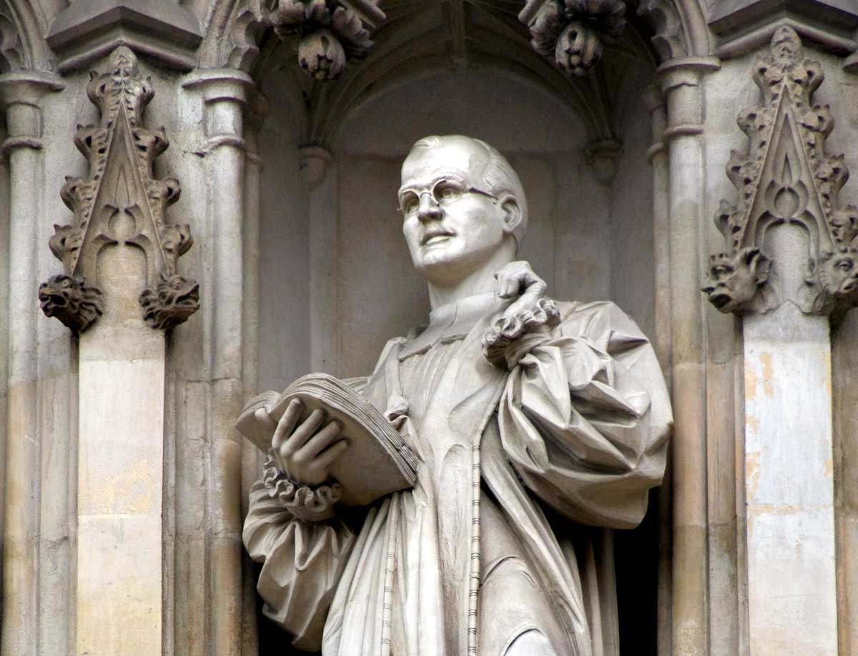
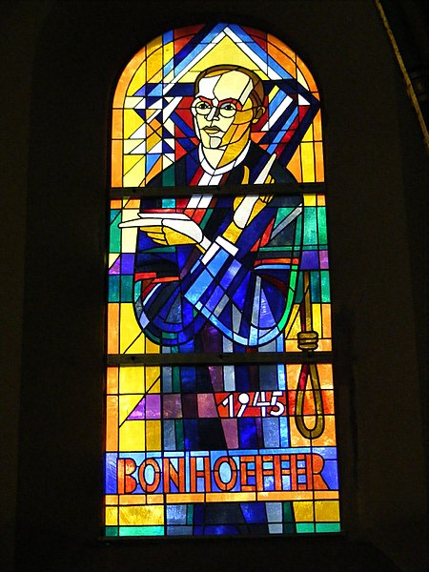
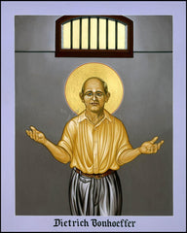
Bonhoeffer as Resistor

Slide 2

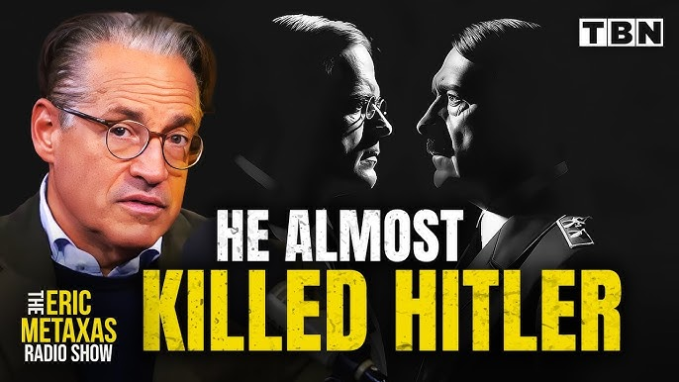



Slide 3
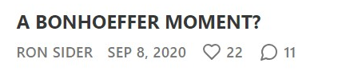
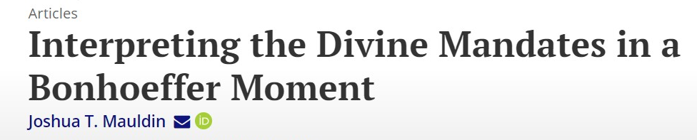

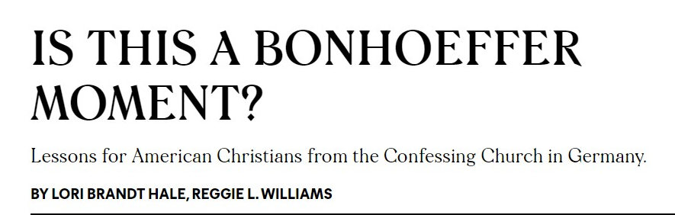
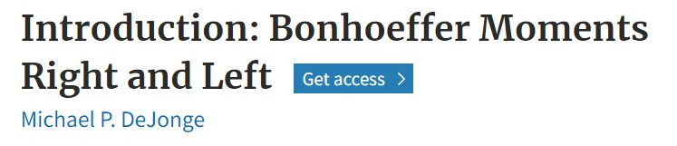
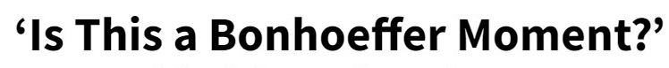
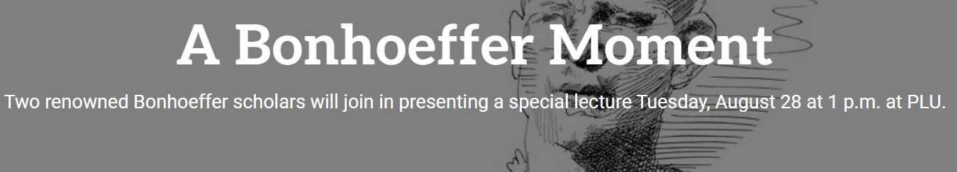

Slide 4
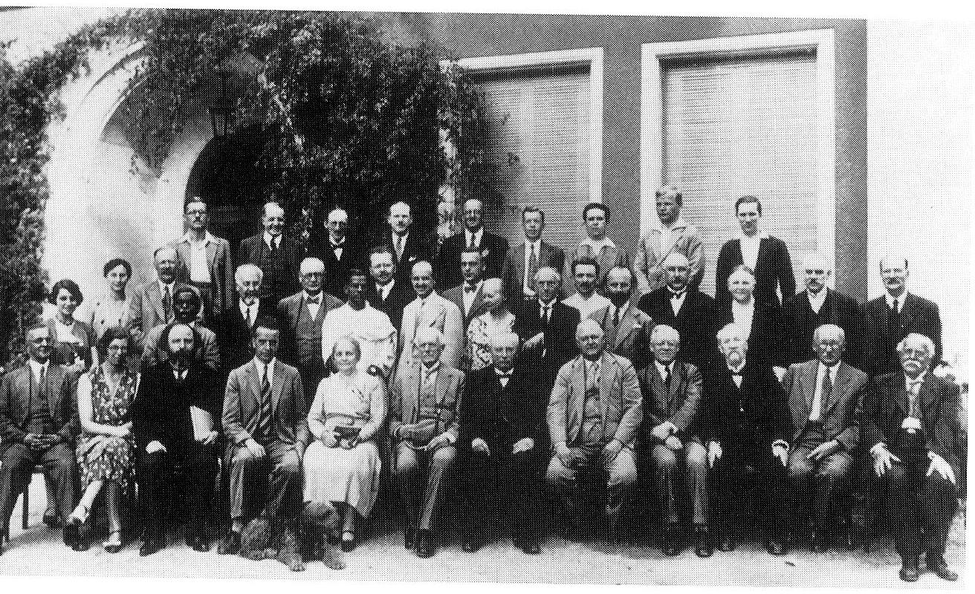
1930-32
Commitment to Ecumenism
  World Alliance for Promoting International Friendship through the Churches
  “There can be no understanding between us Germans and the victorious nations in the world war; we can only show them that as long as they continue the war against us, understanding is impossible.”
  --Paul Althaus and Emmanuel Hirsch, 1931
  “Anyone engaged in ecumenical work must suffer the charges of being unconcerned with the Fatherland and unconcerned with the truth, and any attempt at an encounter is quickly cried down.”
  --Bonhoeffer, 1933

Slide 5
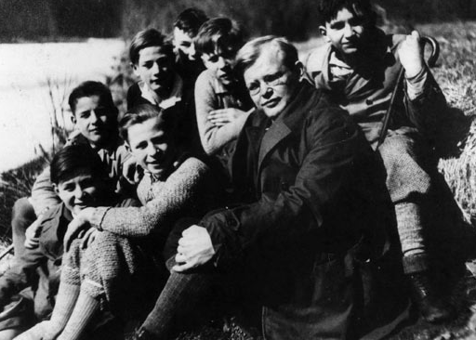
1930-1932
Peace Activism
  “The church knows nothing of any sacredness of war. The struggle for existence is carried on here with inhuman means. The church which prays the ‘Our Father’ asks God only for peace.”
  --Youth Catechism 1931
  “…any form of war service, any preparation for war, is forbidden for the Christian”
        --“Christ and Peace,” 1932
  Criticism of “orders of creation” (völkish) theology in early lectures

Slide 6
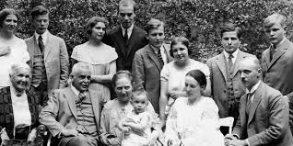
1930-1932
Inner Liberation
“I plunged into work in a very unchristian way. An…ambition that many noticed in me made my life difficult….Then something happened, something that has changed and transformed my life to the present day. For the first time I discovered the Bible….I had often preached, I had seen a great deal of the church, spoken and preached about it—but I had not yet become a Christian….Also I had never prayed, or prayed only very little. For all my loneliness, I was quite pleased with myself. Then the Bible, and in particular the Sermon on the Mount freed me from that….I suddenly saw the Christian pacifism that I had recently passionately opposed as self-evident…”
--private letter, 1936

Slide 7
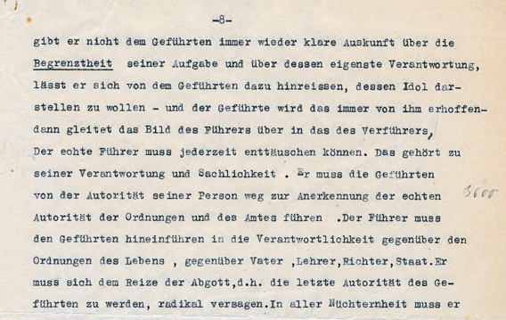
1933
Radio Address on Der Führerprinzip (February 1)
  “If a leader surrenders to followers’ wishes, then the image of the Leader [Führer] gradually becomes the image of the misleader [Verführer].”

Slide 8
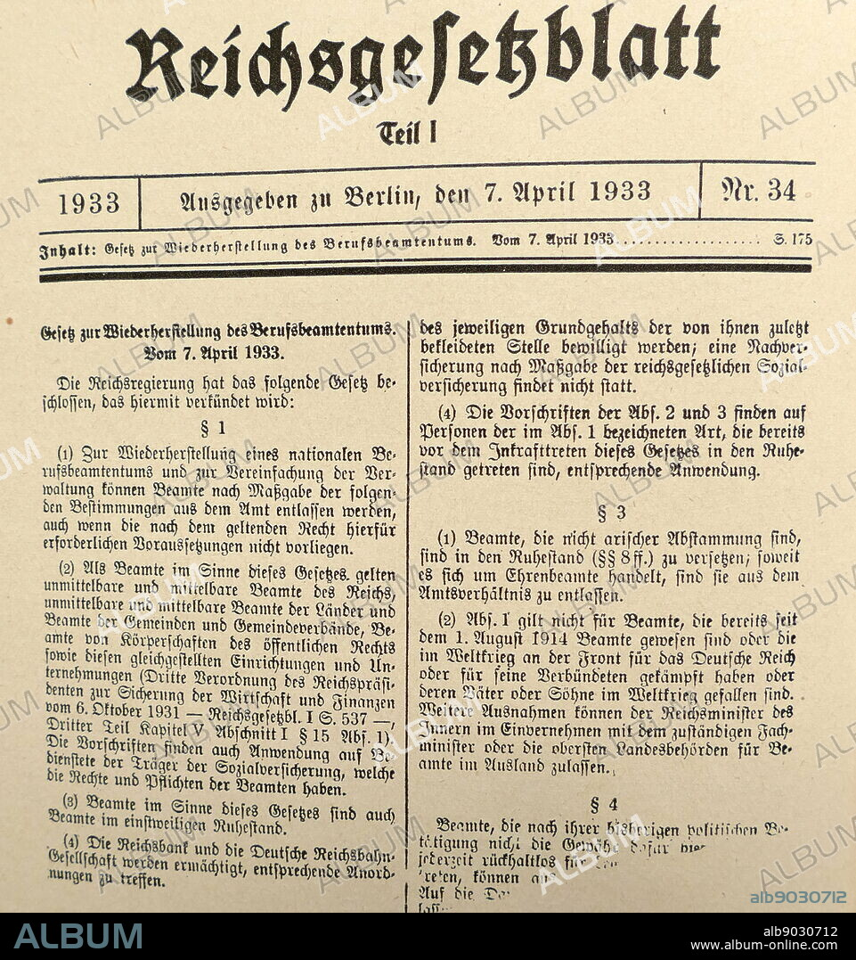
1933
Art. I 1) For the reestablishment of a national professional civil service and for the simplification of administration, officials may be discharged from office according to the following regulations….
Art. II 1) Officials who since 9 November 1918 have attained the status of officials without possessing the required or usual preparation or other qualifications are to be dismissed from service.
Art. III 1) Officials, who are of non-aryan descent, are to be retired: insofar as honorary officials are concerned, they are to be removed from official status.

Slide 9
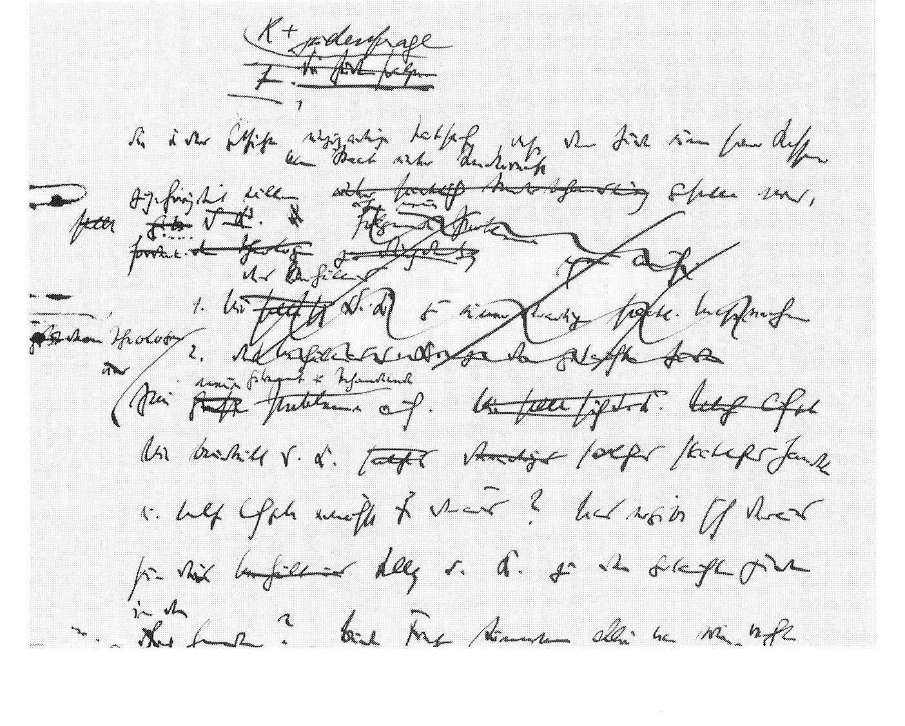
1933
“The Church and the Jewish Question” (April)
“All this means that there are three possible ways in which the church can act toward the state: in the first place…it can ask the state whether its actions are legitimate and in accordance with its character as state….Second, it can aid the victims of state action. The church has an unconditional obligation to the victims of any ordering of society, even if they do not belong to the Christian community….The third possibility is not just to bandage the victims under the wheel, but to jam a spoke in [or seize] the wheel itself.”
application of the “Aryan Paragraph” in the church is not adiaphoron but statu confessionis

Slide 10
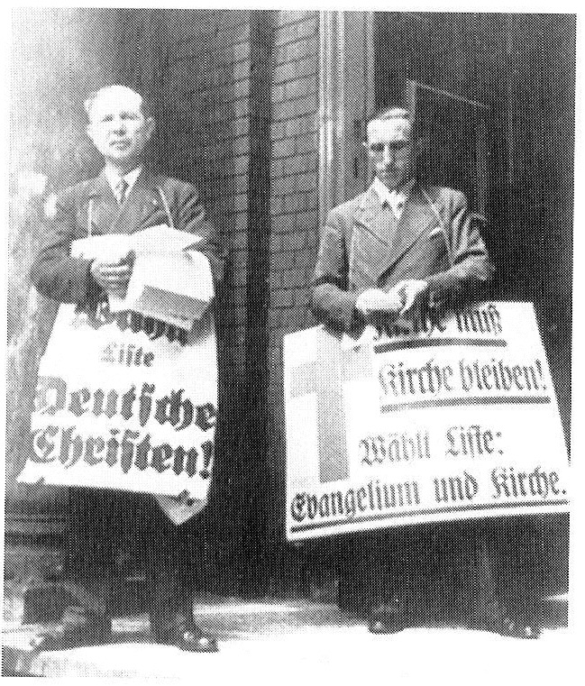
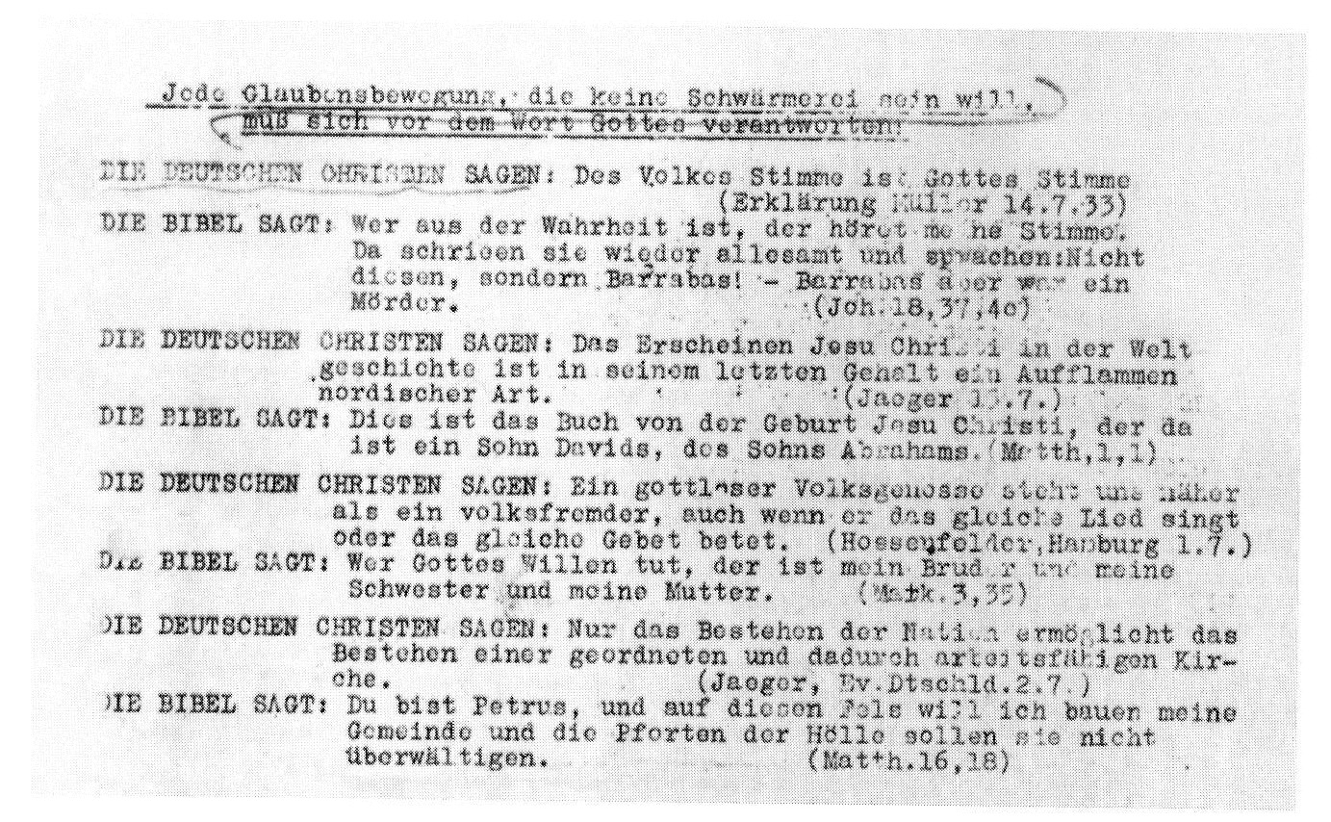
1933
Church
Elections
(July)

Slide 11
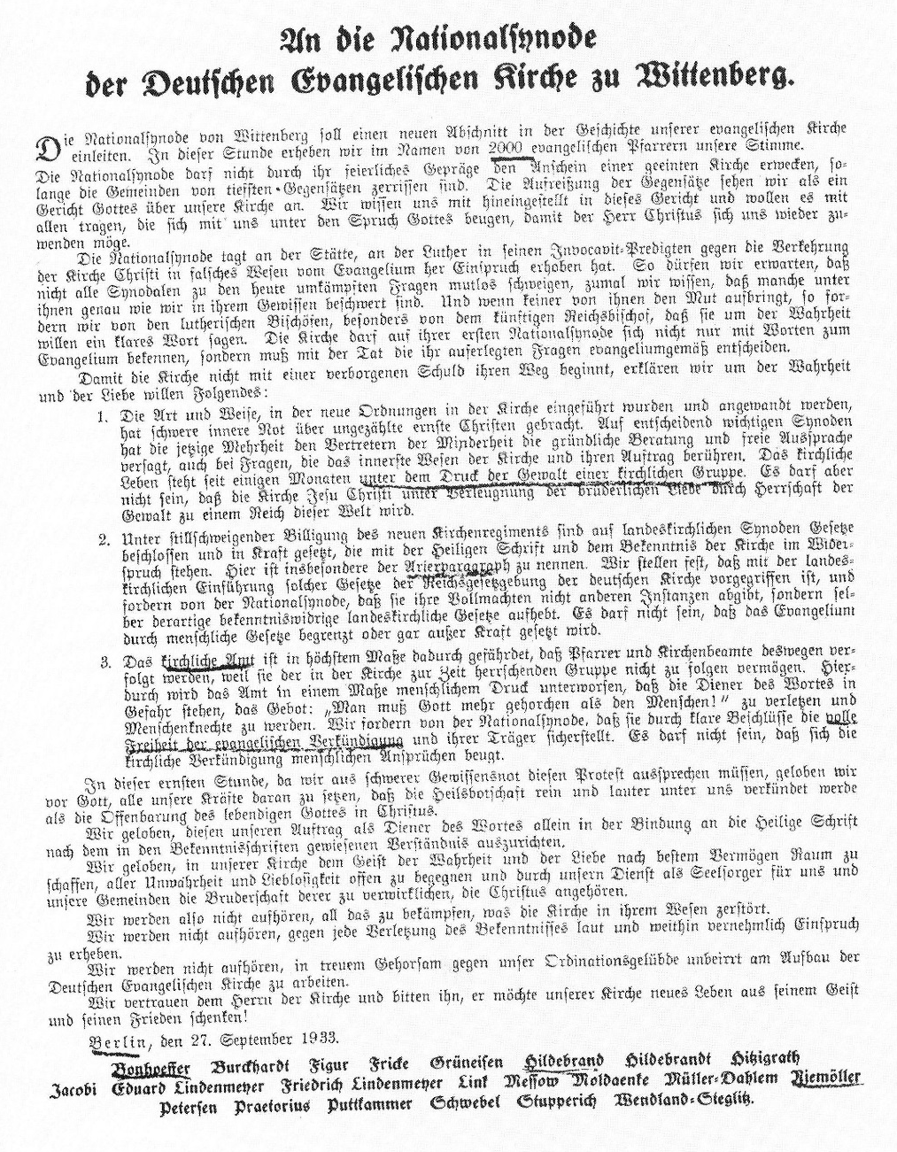
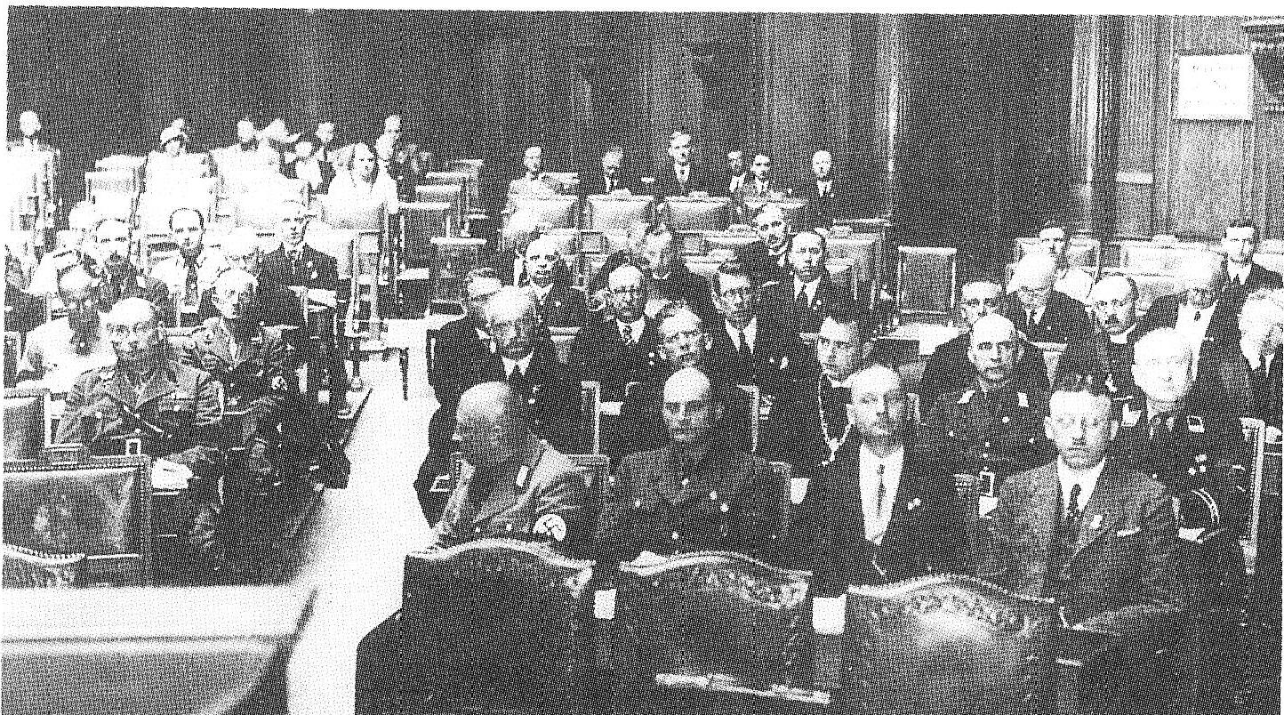
1933
“Brown Synod”
(September)

Slide 12
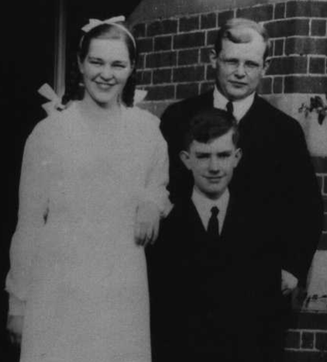
1933
Move to England (October)
  aids German Jews
  threatens to “secede” from national church
  refuses to pledge loyalty to Reichsbischopf

Slide 13
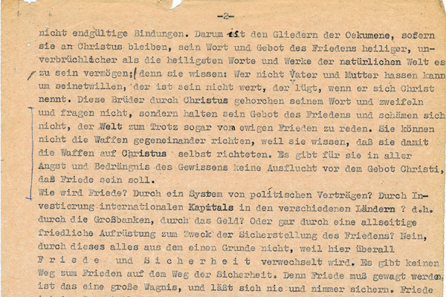
1934
Daring Peace
  “How does peace come about? Through a system of political treaties? Through the investment of international capital in different countries? Through big banks, through money? Or through universal peaceful rearmament in order to guarantee peace? Through none of these, for the single reason that in all of them peace is confused with safety. There is no way to peace along the way of safety. For peace must be dared. It is the great venture. It can never be safe. Peace is the opposite of security.”
--“Peace Sermon,” 1934

Slide 14
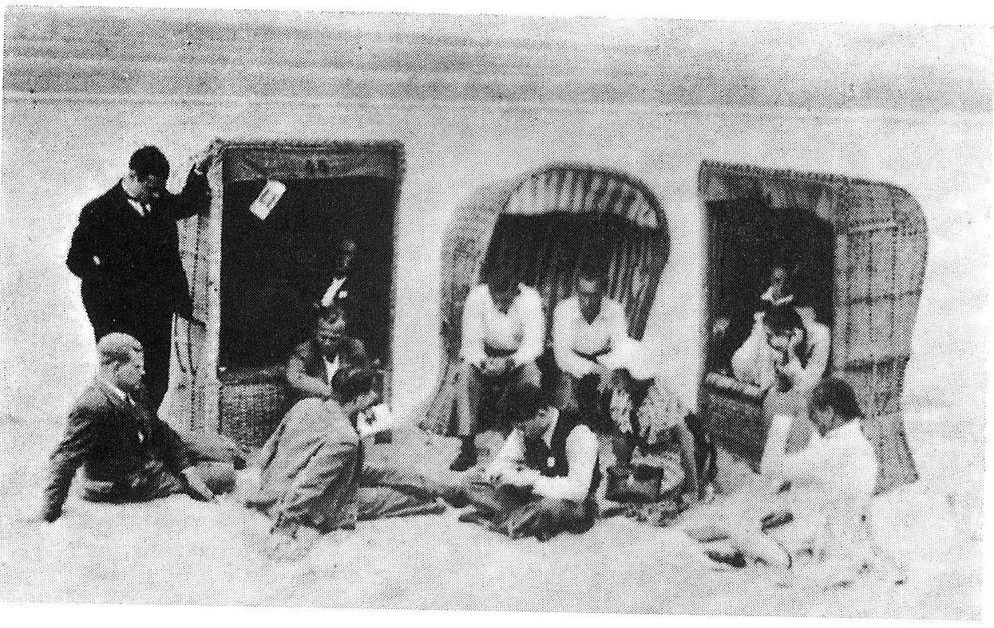
1934
Conscientious Objection
On the beach at Fano in 1934, “a Swede asked, ‘What would you do, sir, if war broke out?’ Reflectively, [Bonhoeffer] allowed the sand to trickle through his fingers, then turned calmly toward the questioner and replied: ‘I pray that God will give me the strength not to take up arms.’”
Conscription introduced in Germany in 1935

Slide 15
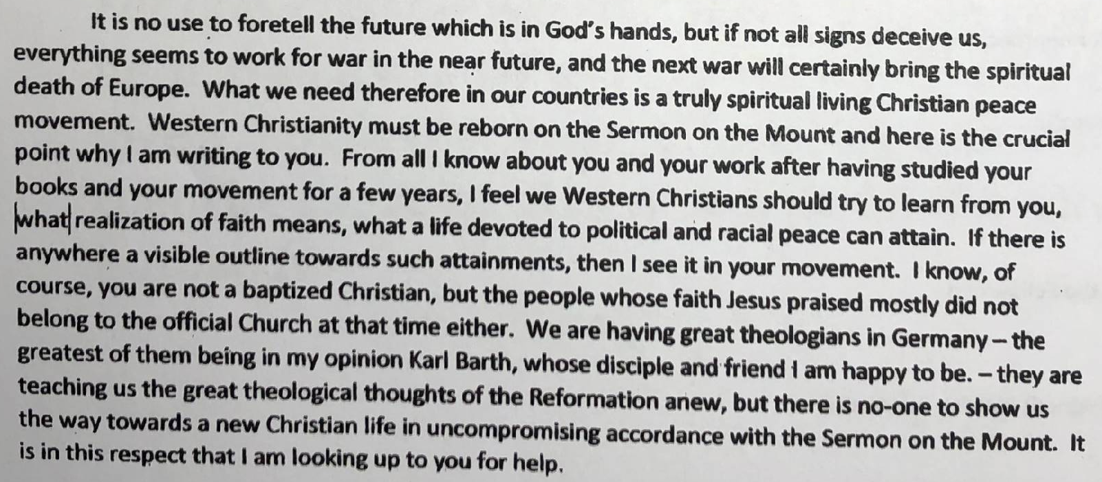
Letter to Ghandi, October 1934

Slide 16
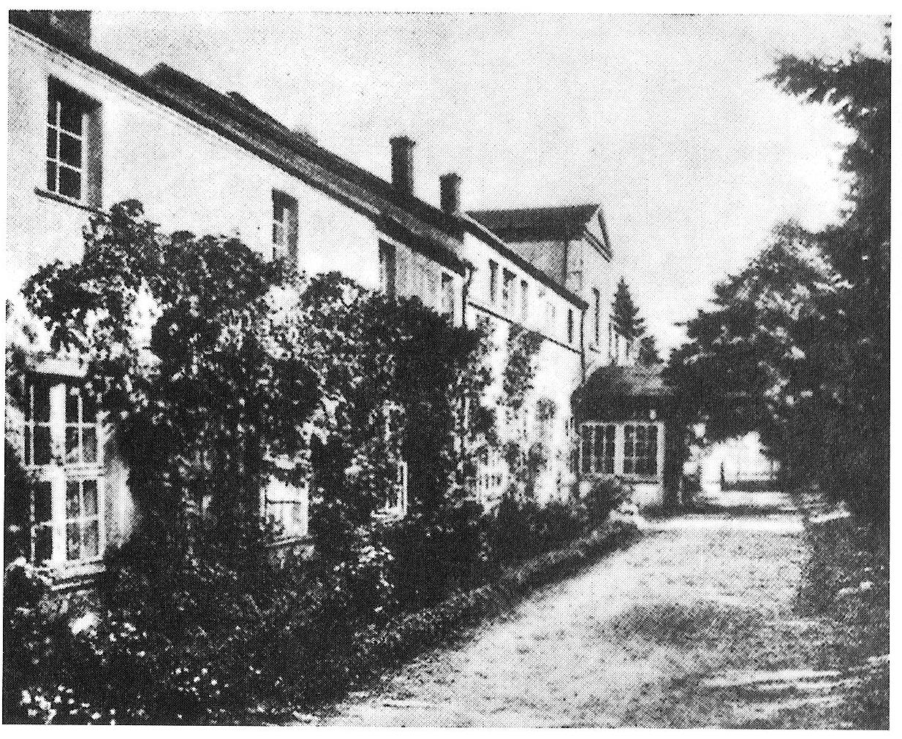
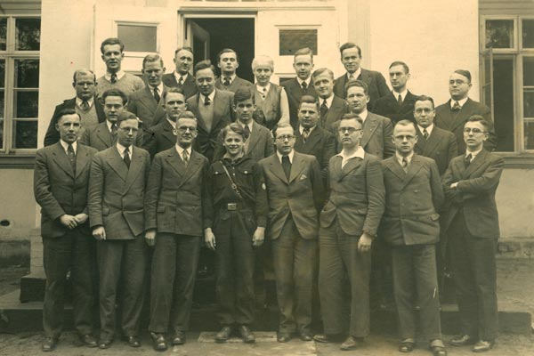
1935-
1937
Preacher’s Seminary at Finkenwalde
  “the restoration of the church must surely depend on a new kind of monasticism, which has nothing in common with the old but a life of uncompromising discipleship, following Crist according to the Sermon on the Mount. I believe the time ahs come to gather people together and do this (letter, 1935)

Slide 17
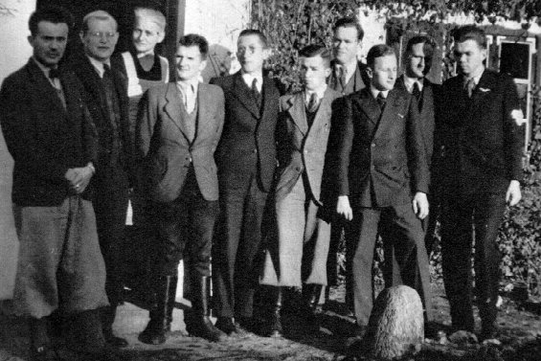
1935-1937
Seminary declared “illegal” in December 1935
Discussions of loyalty oaths and conscription
“whoever knowingly separates himself from the Confessing church in Germany separates himself from salvation” (1936)
Closed in September 1937

Slide 18
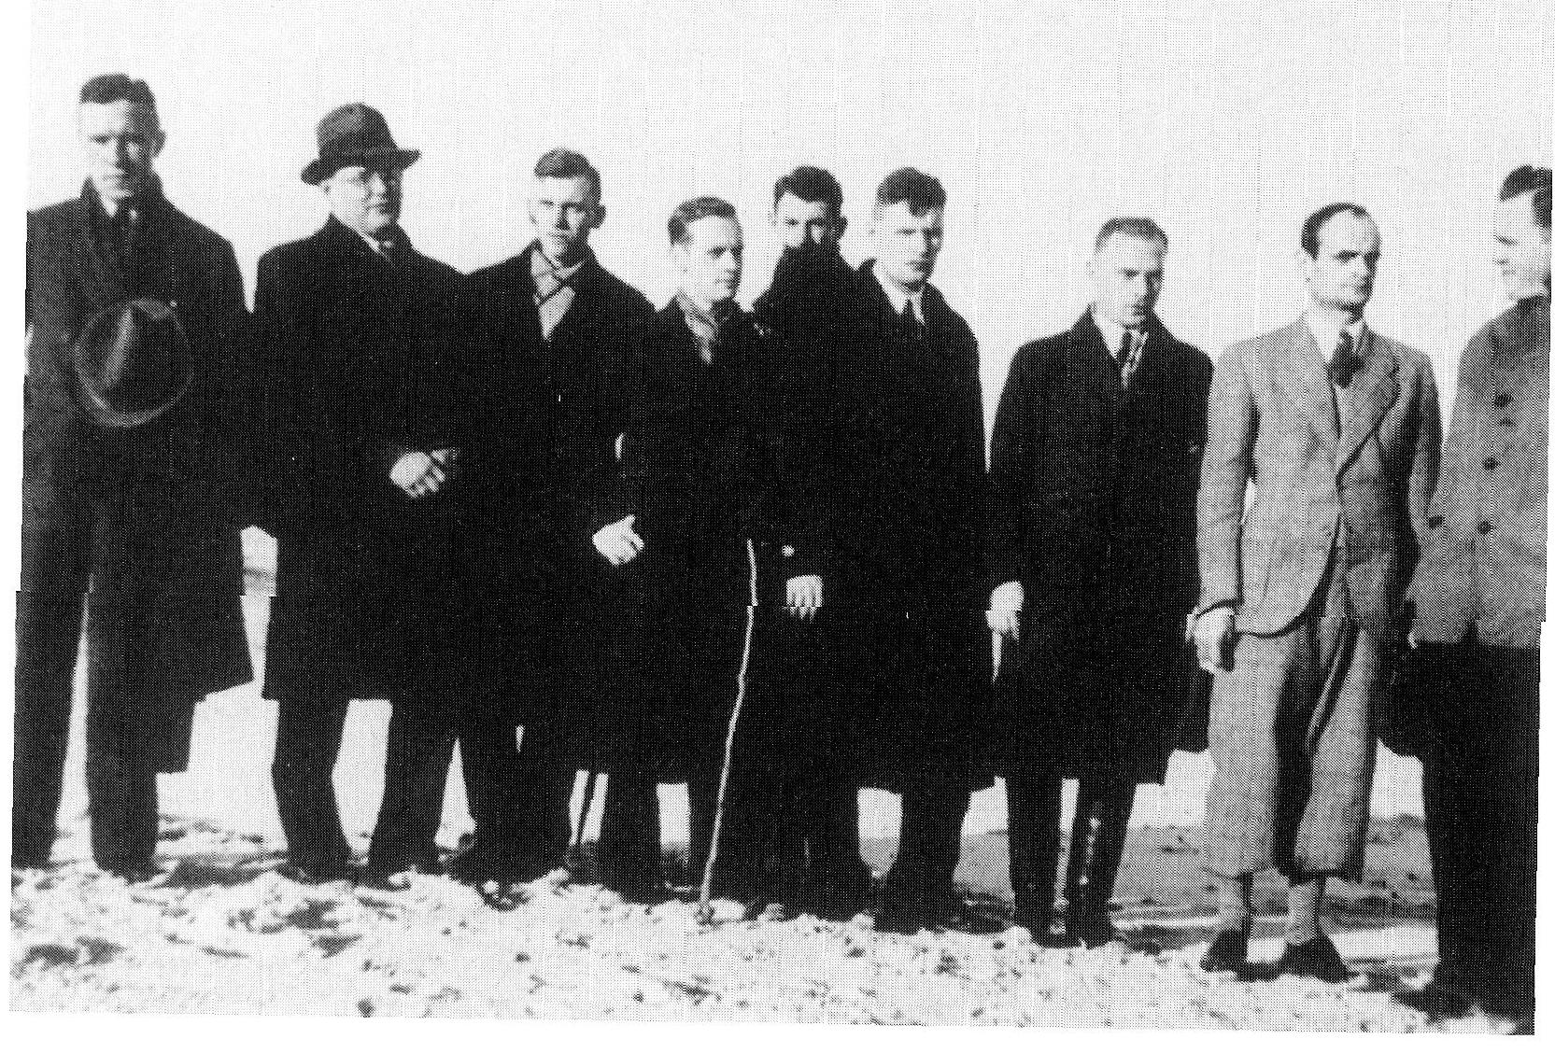
1938-1940
Collective Pastorates
Method of Evading Restrictions
Legalization?
  Confessing Church ordinands could be “legalized” by submitting to reexamination and taking loyalty oath
  “Anyone who is called to a spiritual office is to affirm his loyal duty with the following oath: ‘I swear that I will be faithful and obedient to Adolf Hitler, the Führer of the German Reich and people, that I will conscientiously observe the laws and carry out the duties of my office, so help me God.’ Anyone who refuses to take the oath of allegiance is to be dismissed.”
--20 April 1938, Reich Minister of Church Affairs

Slide 19
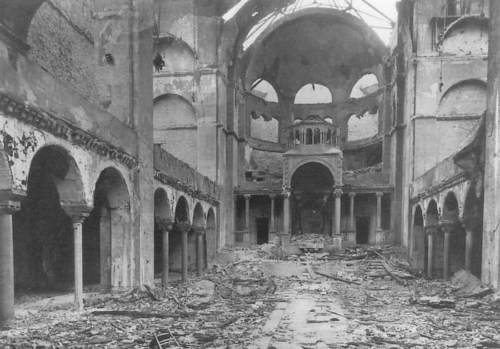
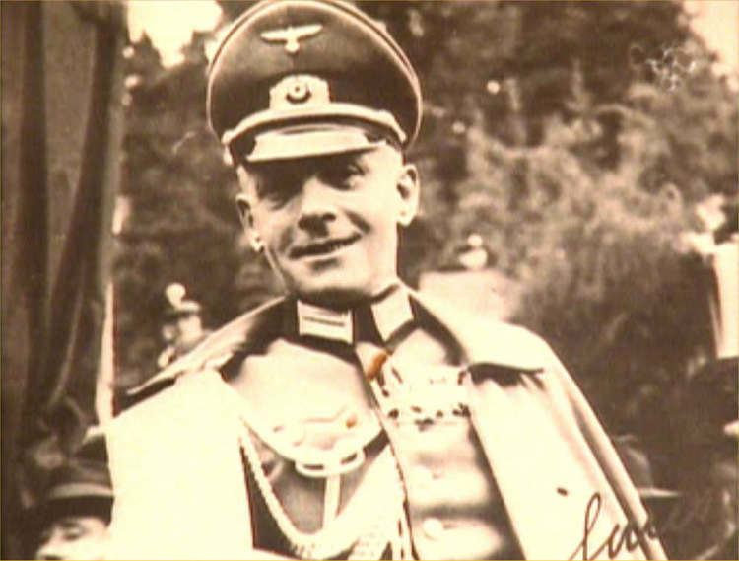
1938
Kristallnacht (November)
“During the last few days I have been thinking a great deal about Psalm 74, Zechariah 2:12 (2:8 ‘he who touches you touches the apple of his eye!’), Romans 9:3f (Israel, to whom belongs the sonship, the glory, the covenant, the law, the serve, the promises), Romans 11:11-15. That takes us right into prayer”
  --Circular Letter of November 20, 1938
First meeting with Hans Oster

Slide 20
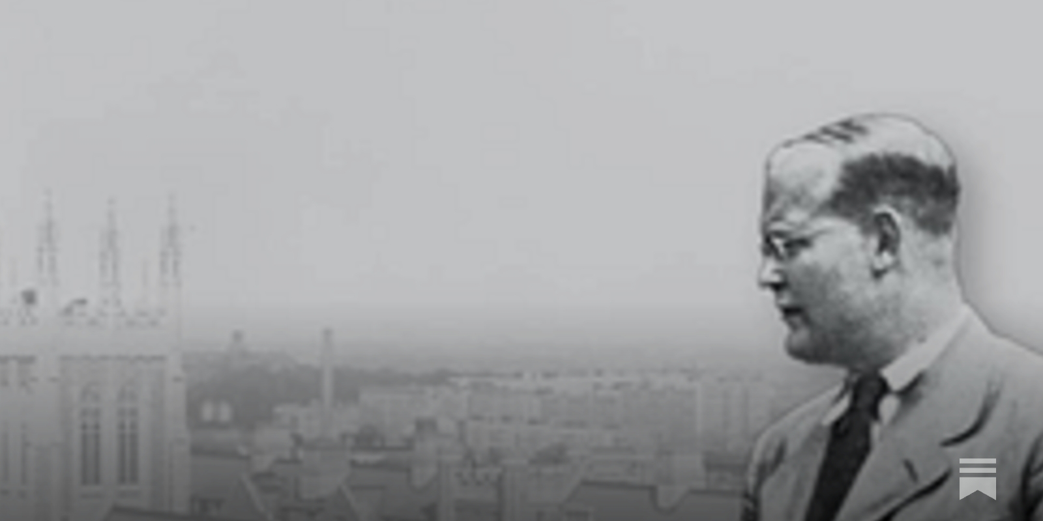
1939
Move to New York (June)
DB receives military call-up May 1939 (1 year deferment secured by father)
“‘I am thinking of leaving Germany sometime. The main reason is the compulsory military service to which men of my age will be called up this year. It seems conscientiously impossible to join in a war under present circumstances….I should cause a tremendous damage to my brethren if I were to make a stand on this point which would be regarded by the regime as typical of the hostility of our Church towards the State.”
  --letter to Bishop George Bell, spring 1939

Slide 21
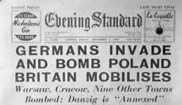
1939
Return to Germany
“I have made the mistake in coming to America. I must live through this difficult period of our national history with the Christian people of Germany. I will have no right to participate in the reconstruction of Christian life in Germany after the war if I do not share the trials of this time with my people…Christians in Germany will face the terrible alternative of either willing the defeat of their nation in order that Christian civilization may survive, or willing the victory of their nation and thereby destroying civilization. I know which of these alternatives I must choose, but I cannot make this choice in security.”
--Letter to Reinhold Niebuhr

Slide 22
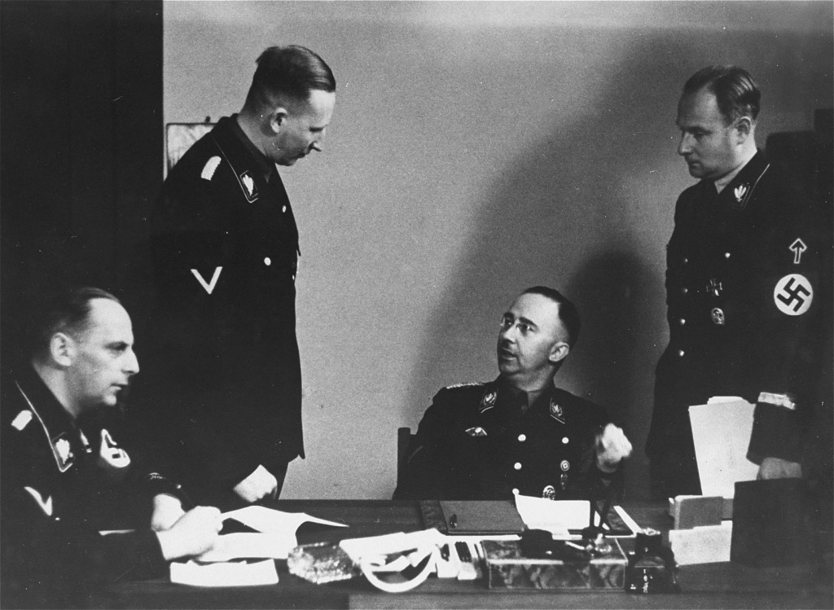
1940
Under Suspicion
Informant reports that DB “talked critically about the treatment of prisoners of war and of women and children belonging to the opposite side”
Security Service Report notes that DB is “activity subverting the people” and leads to prohibitions on traveling, speaking, and publishing
Defense: “My entire outlook my work as well as my background, make it inconceivable for me to allow myself to be identified with circles warranting the stigma of such a charge…Heil Hitler!”

Slide 23
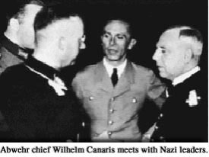
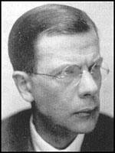
1940
Joins Abwehr through brother-in-law Hans von Dohnanyi, ostensibly to “do his part for the armed forces,” while capitalizing on his “international connections in the ecumenical sector”
Military exemption and SD-issued passport allow him to move freely
3 visits to Switzerland (ecumenical contacts)
1 to Norway (encouraged church resistance)
1 to Sweden (met with Bishop George Bell, produced a list of conspirators, and asked for assurances in event of coup d'état

Slide 24
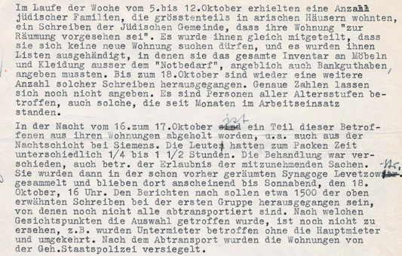
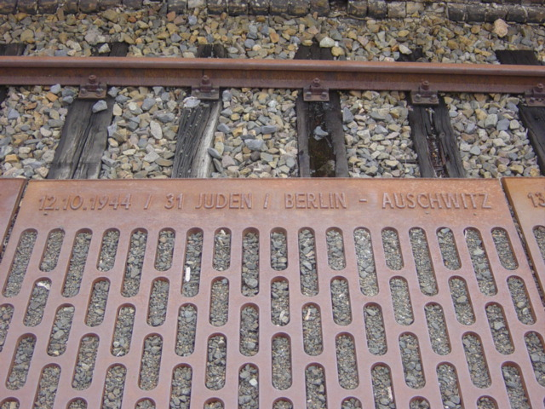
1941
Subverting Nazi Jewish policy, 1
October 1941 report on deportation of Jews from Berlin

Slide 25
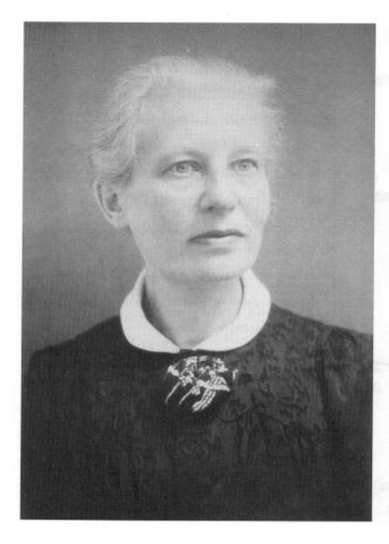
1942
Subverting Nazi Jewish Policy, 2
“Operation 7”
  Responsible for including Charlotte Friedenthal in the group of 14 Jewish-Christian rescuees who would travel to Switzerland, disguised as Abwehr agents
  Under interrogation, Bonhoeffer claimed that conversations about Operation 7 had begun before the deportation of German Jews in October 1941

Slide 26

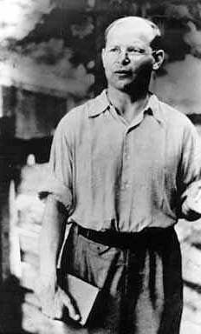
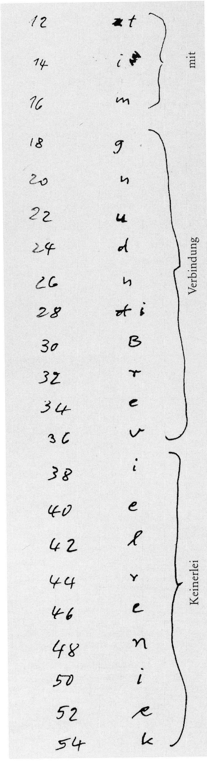
1943-1944
Tegel Military Prison (April 1943-October 1944)
  Interrogation: pretended to be a simple pastor, sought to harmonize testimony with that of other defendants

Slide 27
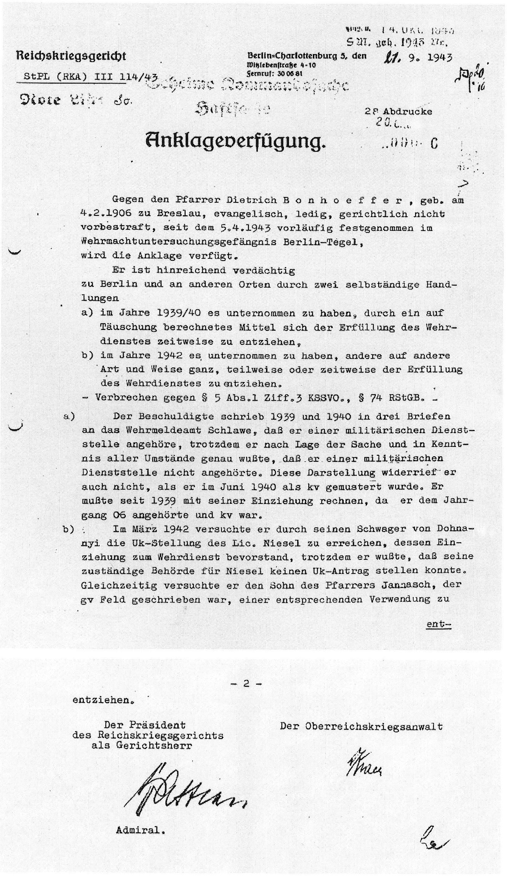
Indictment (September 1944)
  Military exemption was means of escaping observation by the Gestapo as he to continued church work.
  “Operation 7” was a plot to save Charlotte Friedenthal, among others.
  Foreign journeys were unrelated to Military Intelligence.
  Bonhoeffer worked to get Confessing Church officials exemptions from military service.

Slide 28
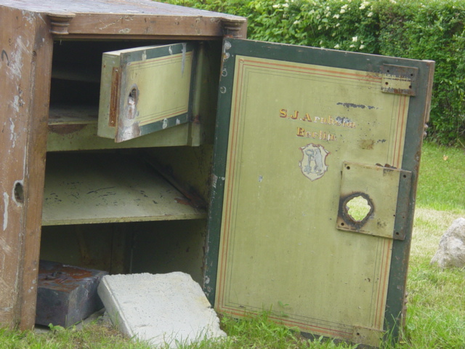
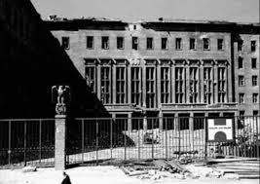
1944-1945
Zossen Documents
  Fate sealed in September 1944 with discovery of correspondence related to DB’s resistance activity
RHSA Prison on Prinz-Albrecht Strasse (October-January)
  “non-anxious presence”
Buchenwald (February-April)
Flossenbürg (April)

